Slide 1

Data Structures
Lecture: AVL Tree
By
Nitish Kumar
Asst. Professor
Lovely Professional University, Punjab

Slide 2
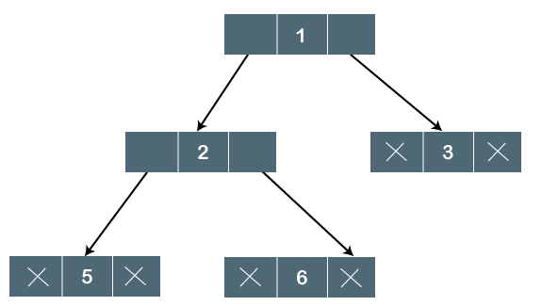
Binary Tree
The Binary tree means that the node can have maximum two children. Here, binary name itself suggests that 'two'; therefore, each node can have either 0, 1 or 2 children.
Let's understand the binary tree through an example.

Slide 3
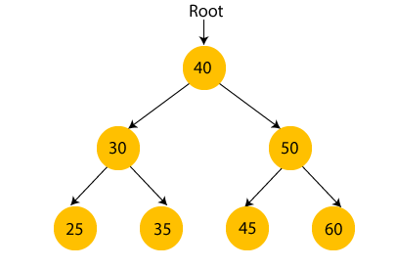
What is a Binary Search tree?
A binary search tree follows some order to arrange the elements. In a Binary search tree, the value of left node must be smaller than the parent node, and the value of right node must be greater than the parent node. This rule is applied recursively to the left and right subtrees of the root.

Slide 4
Motivation
When building a binary search tree, what type of trees would we like? Example: 3, 5, 8, 20, 18, 13, 22
3
5
13
8
5
20
13
18
3
8
18
22
20
22

Slide 5
AVL Tree:
AVL Tree can be defined as height balanced binary search tree in which each node is associated with a balance factor which is calculated by subtracting the height of its right sub-tree from that of its left sub-tree.
Tree is said to be balanced if balance factor of each node is in between -1 to 1, otherwise, the tree will be unbalanced and need to be balanced.
Balance Factor (k) = height (left(k)) - height (right(k))
If balance factor of any node is 1, it means that the left sub-tree is one level higher than the right sub-tree.
If balance factor of any node is 0, it means that the left sub-tree and right sub-tree contain equal height.
If balance factor of any node is -1, it means that the left sub-tree is one level lower than the right sub-tree.

Slide 6
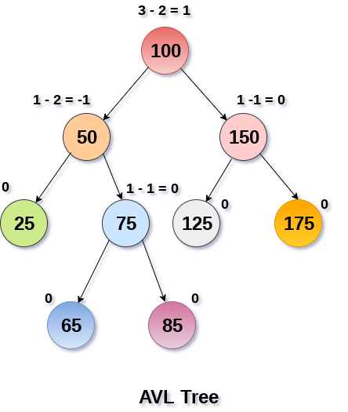

Slide 7
Complete binary tree is hard to build when we allow dynamic insert and remove.
  We want a tree that has the following properties
    Tree height = O(log(N))
    allows dynamic insert and remove with O(log(N)) time complexity.
  The AVL tree is one of this kind of trees.
8
13
5
18
5
20
3
13
20
3
8
18
22
22

Slide 8
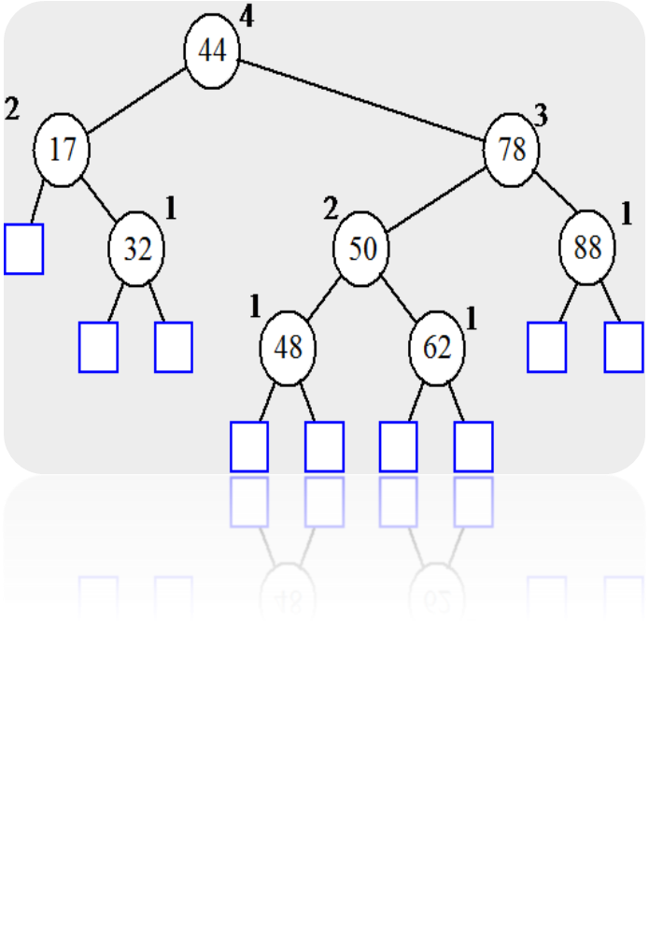
AVL (Adelson-Velskii and Landis) Trees
An AVL Tree is a binary search tree such that for every internal node v of T, the heights of the children of v can differ by at most 1.
An example of an AVL tree where the heights are shown next to the nodes:

Slide 9
AVL tree is a binary search tree with balance condition
  To ensure depth of the tree is O(log(N))
  And consequently, search/insert/remove complexity bound O(log(N))
Balance condition
  For every node in the tree, height of left and right subtree can differ by at most 1

Slide 10
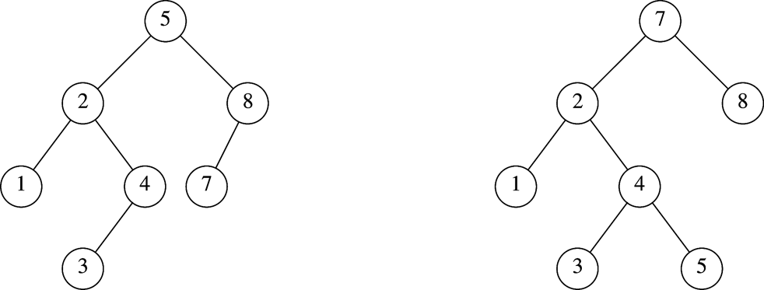
Which is an AVL Tree?

Slide 11
However, insertions and deletions from an AVL tree may disturb the balance factor of the nodes and, thus, rebalancing of the tree may have to be done. The tree is rebalanced by performing rotation at the critical node. There are four types of rotations:
L L rotation: Inserted node is in the left subtree of left subtree of A
R R rotation : Inserted node is in the right subtree of right subtree of A
L R rotation : Inserted node is in the right subtree of left subtree of A
R L rotation : Inserted node is in the left subtree of right subtree of A

Slide 12
AVL Insertion Process
Insertion in an AVL tree is similar to insertion in a binary search tree. But after inserting and element, you need to fix the AVL properties using left or right rotations:
If there is an imbalance in the left child's right sub-tree, perform a left-right rotation
If there is an imbalance in the left child's left sub-tree, perform a right rotation
If there is an imbalance in the right child's right sub-tree, perform a left rotation
If there is an imbalance in the right child's left sub-tree, perform a right-left rotation

Slide 13
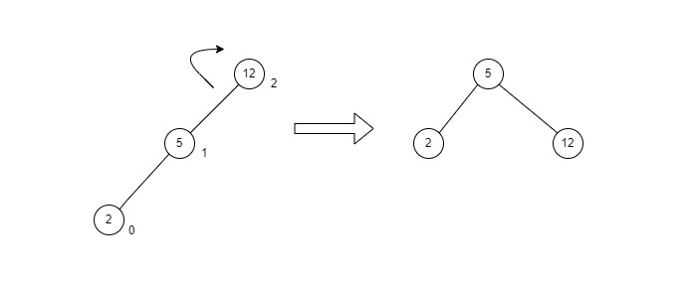
LL Rotations
LL rotation is performed when the node is inserted into the right subtree leading to an unbalanced tree. This is a single left rotation to make the tree balanced again −

Slide 14
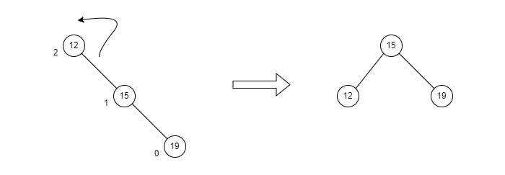
RR Rotations
RR rotation is performed when the node is inserted into the left subtree leading to an unbalanced tree. This is a single right rotation to make the tree balanced again −

Slide 15
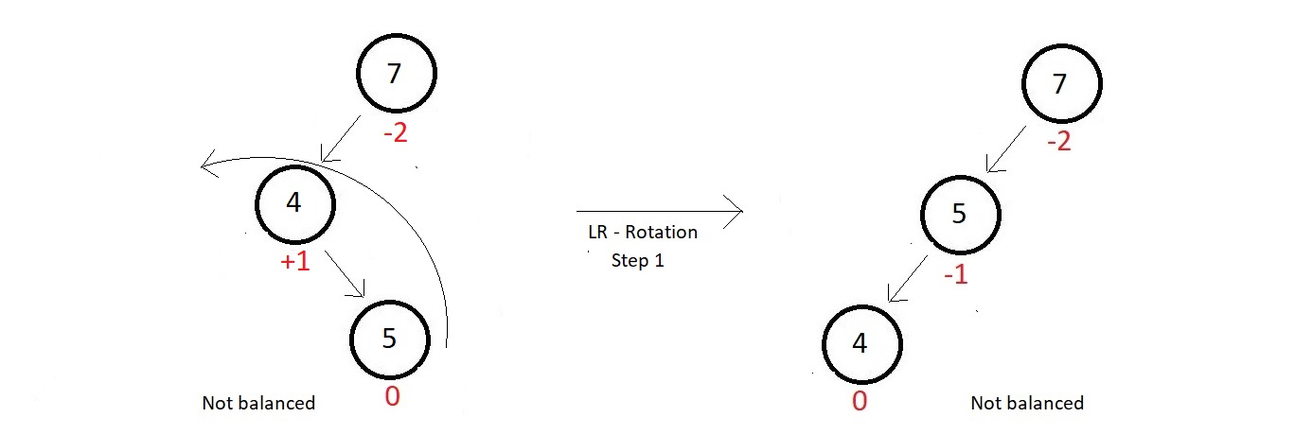
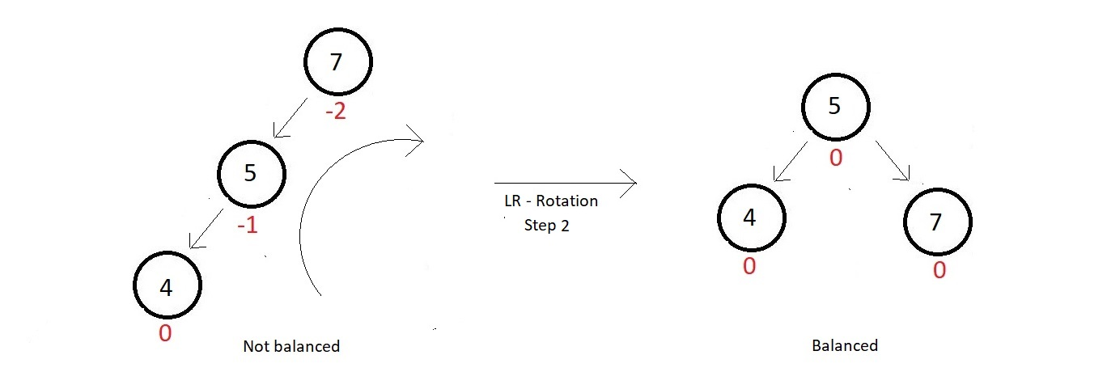
LR Rotations
LR rotation is the extended version of the previous single rotations, also called a double rotation. It is performed when a node is inserted into the right subtree of the left subtree. The LR rotation is a combination of the left rotation followed by the right

Slide 16
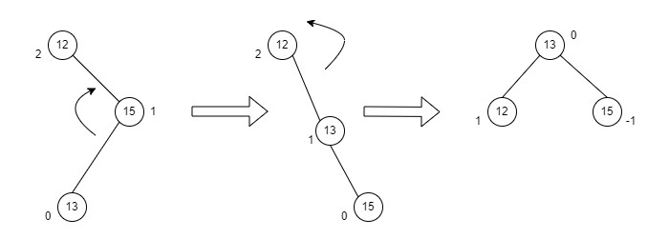
RL Rotations
RL rotation is also the extended version of the previous single rotations, hence it is called a double rotation and it is performed if a node is inserted into the left subtree of the right subtree. The RL rotation is a combination of the right rotation followed by the left rotation. There are multiple steps to be followed to carry this out.

Slide 17
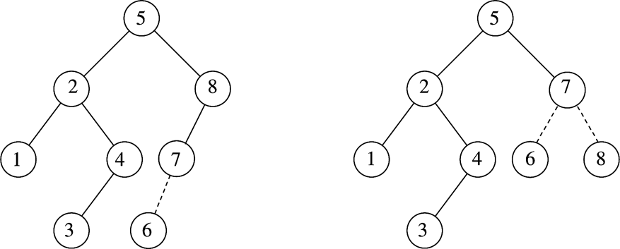
Example
After inserting 6
  Balance condition at node 8 is violated

Slide 18
Example
Inserting 3, 2, 1, and then 4 to 7 sequentially into empty AVL tree
3
2
2
1
3
1

Slide 19
Inserting 4
Inserting 5
2
1
3
4
2
2
1
3
4
1
4
5
3
5

Slide 20
4
Inserting 6
Inserting 7
2
2
5
1
4
1
3
6
3
5
6
4
4
2
6
2
5
1
3
5
7
1
3
6
7

Slide 21
Example
Continuing the previous example by inserting
  16 down to 10, and then 8 and 9
Inserting 16 and 15
4
4
2
6
2
6
1
3
5
15
1
3
5
7
7
16
16
15

Slide 22
Best case time complexity of traverse operation in AVL tree.
A. O(1)
B. O(log n)
C. O(n)
D. None of these

Slide 23
Inserting 14
4
4
2
7
2
6
1
3
6
15
1
3
5
15
14
16
7
16
5
14

Slide 24
Worst case time complexity of insertin of element in AVL tree.
A. O(1)
B. O(log n)
C. O(n)
D. None of these

Slide 25
Algorithm
The following steps are involved in performing the insertion operation of an AVL Tree −
Step 1 − Create a node
Step 2 − Check if the tree is empty
Step 3 − If the tree is empty, the new node created will become the root node of the AVL Tree.
Step 4 − If the tree is not empty, we perform the Binary Search Tree insertion operation and check the balancing factor of the node in the tree.
Step 5 − Suppose the balancing factor exceeds ±1, we apply suitable rotations on the said node and resume the insertion from

Slide 26

Questions

